Slide 1
Approximation Algorithms
Is Close Enough Good Enough?
(Thanks to D. Moshkovitz)
Complexity

Slide 2
Motivation
By now we’ve seen many NP-Complete problems.
We conjecture none of them has polynomial time algorithm.
Complexity

Slide 3

Motivation
Is this a dead-end? Should we give up altogether?
?
Complexity

Slide 4

Motivation
Or maybe we can settle for good approximation algorithms?
Complexity

Slide 5
Introduction
Objectives:
  To formalize the notion of approximation.
  To demonstrate several such algorithms.
Overview:
  Optimization and Approximation
  VERTEX-COVER, SET-COVER
Complexity

Slide 6

Optimization
Many of the problems we’ve encountered so far are really optimization problems.
I.e - the task can be naturally rephrased as finding a maximal/minimal solution.
For example: finding a maximal clique in a graph.
Complexity

Slide 7
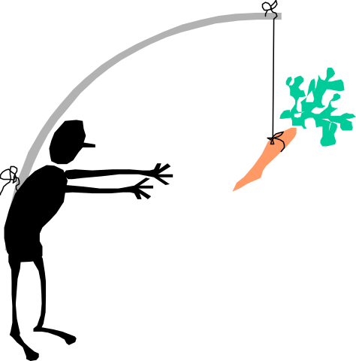
Approximation
An algorithm that returns an answer C which is “close” to the optimal solution C* is called an approximation algorithm.
“Closeness” is usually measured by the ratio bound ρ(n) the algorithm produces.
Which is a function that satisfies, for any input size n, max{C/C*,C*/C}≤ρ(n).
Complexity

Slide 8

Network Power
Say you have a network, with links between some components
Each link requires power supply, hence, you need to supply power to a set of nodes that cover all links
Obviously, you’d like to connect the smallest number of nodes
Complexity

Slide 9
VERTEX-COVER
Instance: an undirected graph G=(V,E).
Problem: find a set C⊆V of minimal size s.t. for any (u,v)∈E, either u∈C or v∈C.
Example:
Complexity

Slide 10
Minimum VC NP-hard
Proof: It is enough to show the decision problem below is NP-Complete:
Instance: an undirected graph G=(V,E) and a number k.
Problem: to decide if there exists a set V’⊆V of size k s.t for any (u,v)∈E, u∈V’ or v∈V’.
This follows immediately from the following observation.
Complexity

Slide 11
Minimum VC NP-hard
Observation: Let G=(V,E) be an undirected graph. The complement V\C of a vertex-cover C is an independent-set of G.
Proof: Two vertices outside a vertex-cover cannot be connected by an edge. 
Complexity

Slide 12
VC - Approximation Algorithm
COR(B) 523-524
C ← φ
E’ ← E
while E’ ≠ φ
  do let (u,v) be an arbitrary edge of E’
  C ← C ∪ {u,v}
  remove from E’ every edge incident to either u or v.
return C.
Complexity

Slide 13
Demo
Compare this cover to the one from the example
Complexity

Slide 14
Polynomial Time
C ← φ
E’ ← E
while E’ ≠ φ do
  let (u,v) be an arbitrary edge of E’
  C ← C ∪ {u,v}
  remove from E’ every edge incident to either u or v
return C
O(n²)
O(1)
O(n²)
O(n)
Complexity

Slide 15

Correctness
The set of vertices our algorithm returns is clearly a vertex-cover, since we iterate until every edge is covered.
Complexity

Slide 16
How Good an Approximation is it?
Observe the set of edges our algorithm chooses
no common vertices!
⇒ any VC contains 1 in each
our VC contains both, hence at most twice as large
Complexity

Slide 17

Mass Mailing
Say you’d like to send some message to a large list of people (e.g. all campus)
There are some available mailing-lists, however, the moderator of each list charges $1 for each message sent
You’d like to find the smallest set of lists that covers all recipients
Complexity

Slide 18
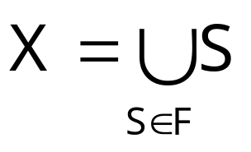
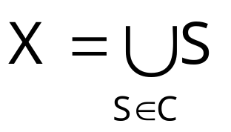
SET-COVER
Instance: a finite set X and a family F of subsets of X, such that
Problem: to find a set C⊆F of minimal size which covers X, i.e -
Complexity

Slide 19
SET-COVER: Example
Complexity

Slide 20

SET-COVER is NP-Hard
Proof: Observe the corresponding decision problem.
Clearly, it’s in NP (Check!).
We’ll sketch a reduction from (decision) VERTEX-COVER to it:
Complexity

Slide 21
VERTEX-COVER ≤_{p} SET-COVER
one element for every edge
VC
VC
SC
one set for every vertex, containing the edges it covers
Complexity

Slide 22

The Greedy Algorithm
COR(B) 530-533
C ← φ
U ← X
while U ≠ φ do
  select S∈F that maximizes |S∩U|
  C ← C ∪ {S}
  U ← U - S
return C
min{|X|,|F|}
O(|F|·|X|)
Complexity

Slide 23
Demonstration
compare to the optimal cover
0
1
2
3
4
5
Complexity

Slide 24
Is Being Greedy Worthwhile? How Do We Proceed From Here?
We can easily bound the approximation ratio by logn.
A more careful analysis yields a tight bound of lnn.
Complexity

Slide 25
The Trick
We’d like to compare the number of subsets returned by the greedy algorithm to the optimal
The optimal is unknown, however, if it consists of k subsets, then any part of the universe can be covered by k subsets!
Which is exactly what the next 3 distinct arguments take advantage of
Complexity

Slide 26
Loose Ratio-Bound
Claim: If ∃ cover of size k, then after k iterations the algorithm have covered at least ½ of the elements
the n elements
Suppose it doesn’t and observe the situation after k iterations:
>½
already covered
Complexity

Slide 27
Loose Ratio-Bound
Claim: If ∃ cover of size k, then after k iterations the algorithm have covered at least ½ of the elements
Since this part → can also be covered by k sets...
the n elements
>½
already covered
Complexity

Slide 28
Loose Ratio-Bound
Claim: If ∃ cover of size k, then after k iterations the algorithm have covered at least ½ of the elements
the n elements
there must be a set not chosen yet, whose size is at least ½n·1/k
>½
already covered
Complexity

Slide 29
Loose Ratio-Bound
Claim: If ∃ cover of size k, then after k iterations the algorithm have covered at least ½ of the elements
and the claim is proven!
the n elements
>½
Thus in each of the k iterations we’ve covered at least ½n·1/k new elements
already covered
Complexity

Slide 30
Loose Ratio-Bound
Claim: If ∃ cover of size k, then after k iterations the algorithm covered at least ½ of the elements.
Therefore after klogn iterations (i.e - after choosing klogn sets) all the n elements must be covered, and the bound is proved.
Complexity

Slide 31
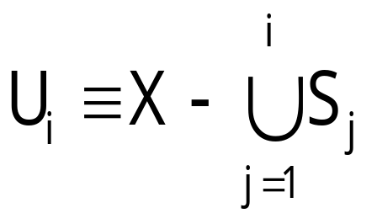
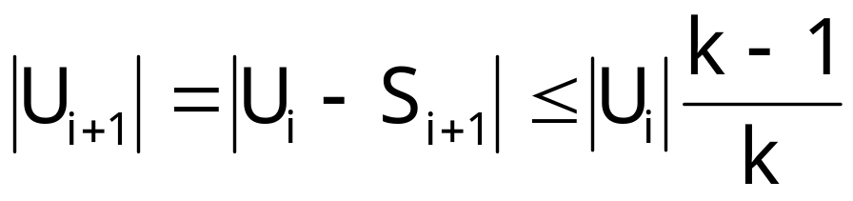
Better Ratio Bound
Let S₁, …, S_{t} be the sequence of sets outputted by the greedy algorithm. Let, for 0 ≤ i ≤ t
Since, for every i, U_{i} can be covered by k sets, it follows
Complexity

Slide 32
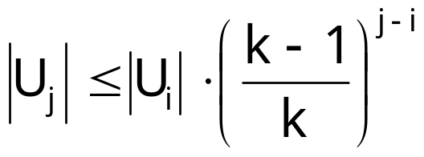
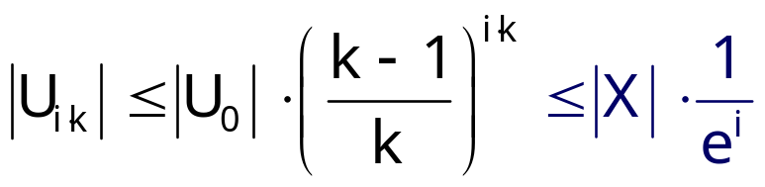
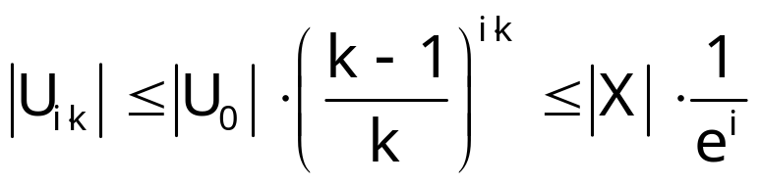
Better Ratio Bound
Hence, for any 0 ≤ i < j ≤ t
Which implies that for every i
Therefore, t ≤ k ln(n) + 1
Complexity

Slide 33
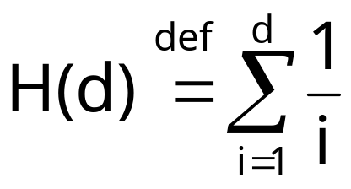
Tight Ratio-Bound
Claim: The greedy algorithm approximates the optimal set-cover to within a factor
H(max{ |S|: S∈F } )
Where H(d) is the d-th harmonic number:
Complexity

Slide 34
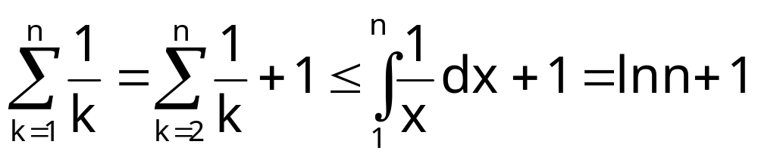
Tight Ratio-Bound
Complexity

Slide 35
Claim’s Proof
Charge $1 for each set
Split cost between covered elements
Bound from above the total fees paid
0.2
0.2
each recipient pays the fractional cost for the first mailing-list it appears in
0.2
0.2
0.2
Complexity

Slide 36
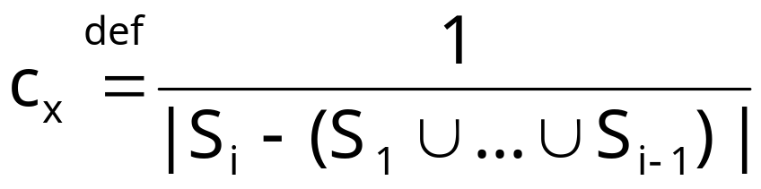
Analysis
Thus, every element x∈X is charged
Where S_{i} is the first set that covers x.
c_{x}
Complexity

Slide 37
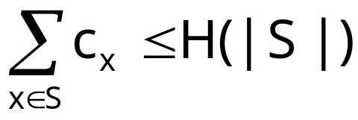
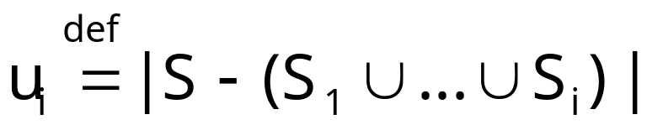
Lemma
number of members of S still uncovered after i iterations
Lemma: For every S∈F
Proof: Fix an S∈F. For any i, let
∀1≤i≤k : S_{i} covers u_{i-1}-u_{i} elements of S
Let k be the smallest index, s.t. u_{k}=0
Complexity

Slide 38
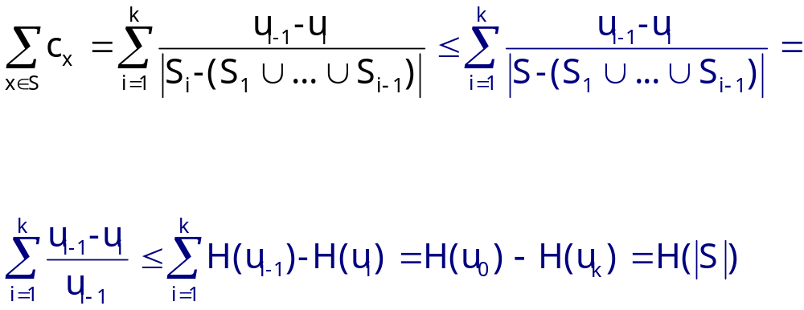
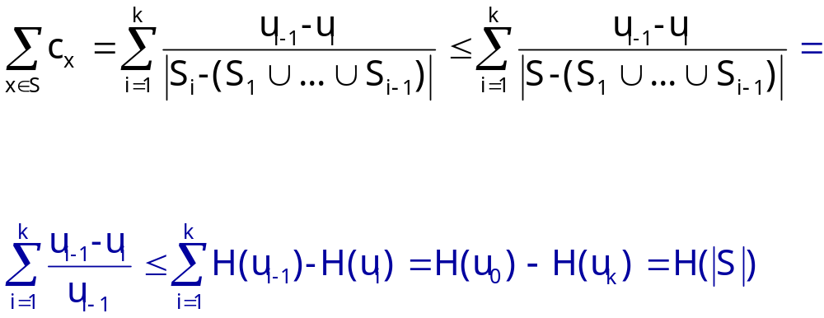
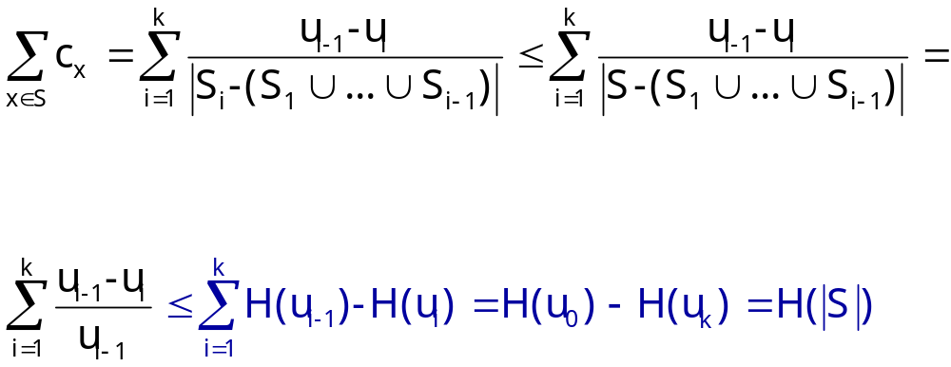
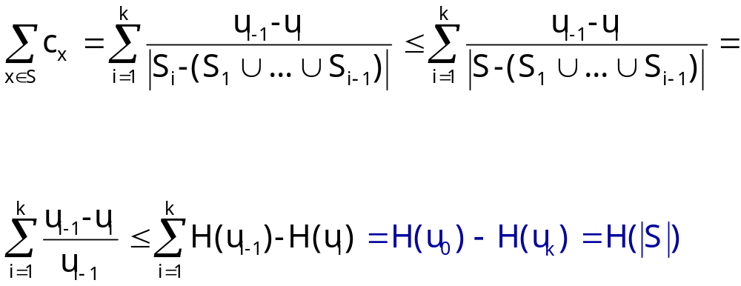
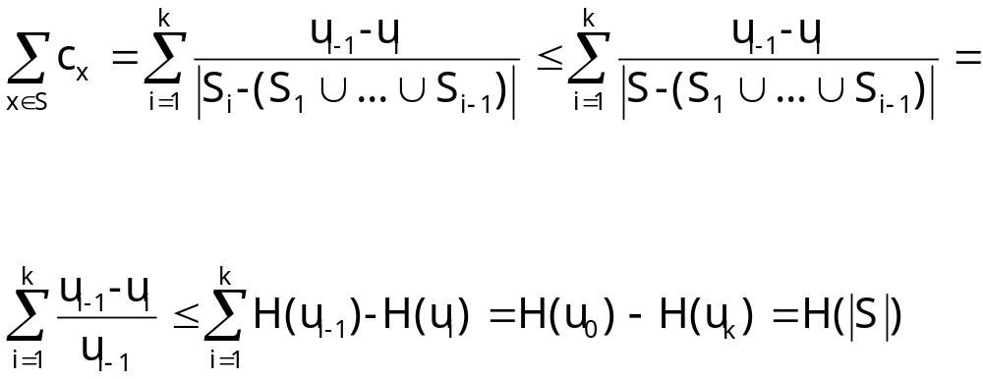
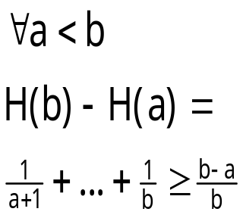
Lemma
sum charges
else greedy strategy would have taken S instead of S_{i}
definition of u_{i-1}
H(u_{k})=H(0)=0
H(u₀)=H(|S|)
Telescopic sum
Complexity

Slide 39
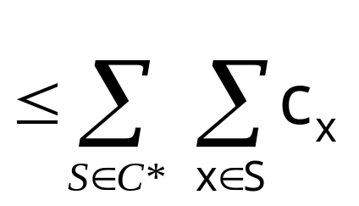
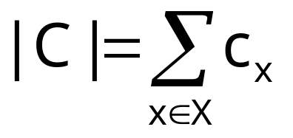
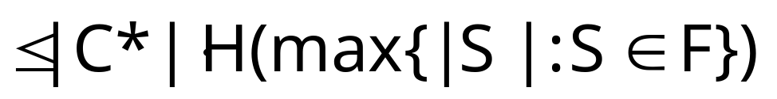
Analysis
Now we can finally complete our analysis:
Complexity

Slide 40
Summary
◉
As it turns out, we can sometimes find efficient approximation algorithms for NP-hard problems.
We’ve seen two such algorithms:
  for VERTEX-COVER (factor 2)
  for SET-COVER (logarithmic factor).
Complexity

Slide 41
What’s Next?
◉
But where can we draw the line?
Does every NP-hard problem have an approximation?
And to within which factor?
Can approximation be NP-hard as well?!
Complexity

